Slide 1
CodeVision
Deepak Indrajeet Jaiswar
Gopal Chandrashekhar Gawas
Rohit Shashikant Gupta
Vishwajeet Ramanujan Gupta

Slide 2
Problem Statement
As global populations continue to rise, the agriculture sector faces immense pressure to increase crop yields while conserving resources and reducing environmental impact. Farmers struggle to make data-driven decisions regarding crop health, irrigation needs, pest management, soil quality, and optimal planting times due to limited access to real-time data and predictive insights. Weather variability, soil nutrient depletion, and unpredictable pest infestations further complicate their efforts to achieve high productivity.

Slide 3
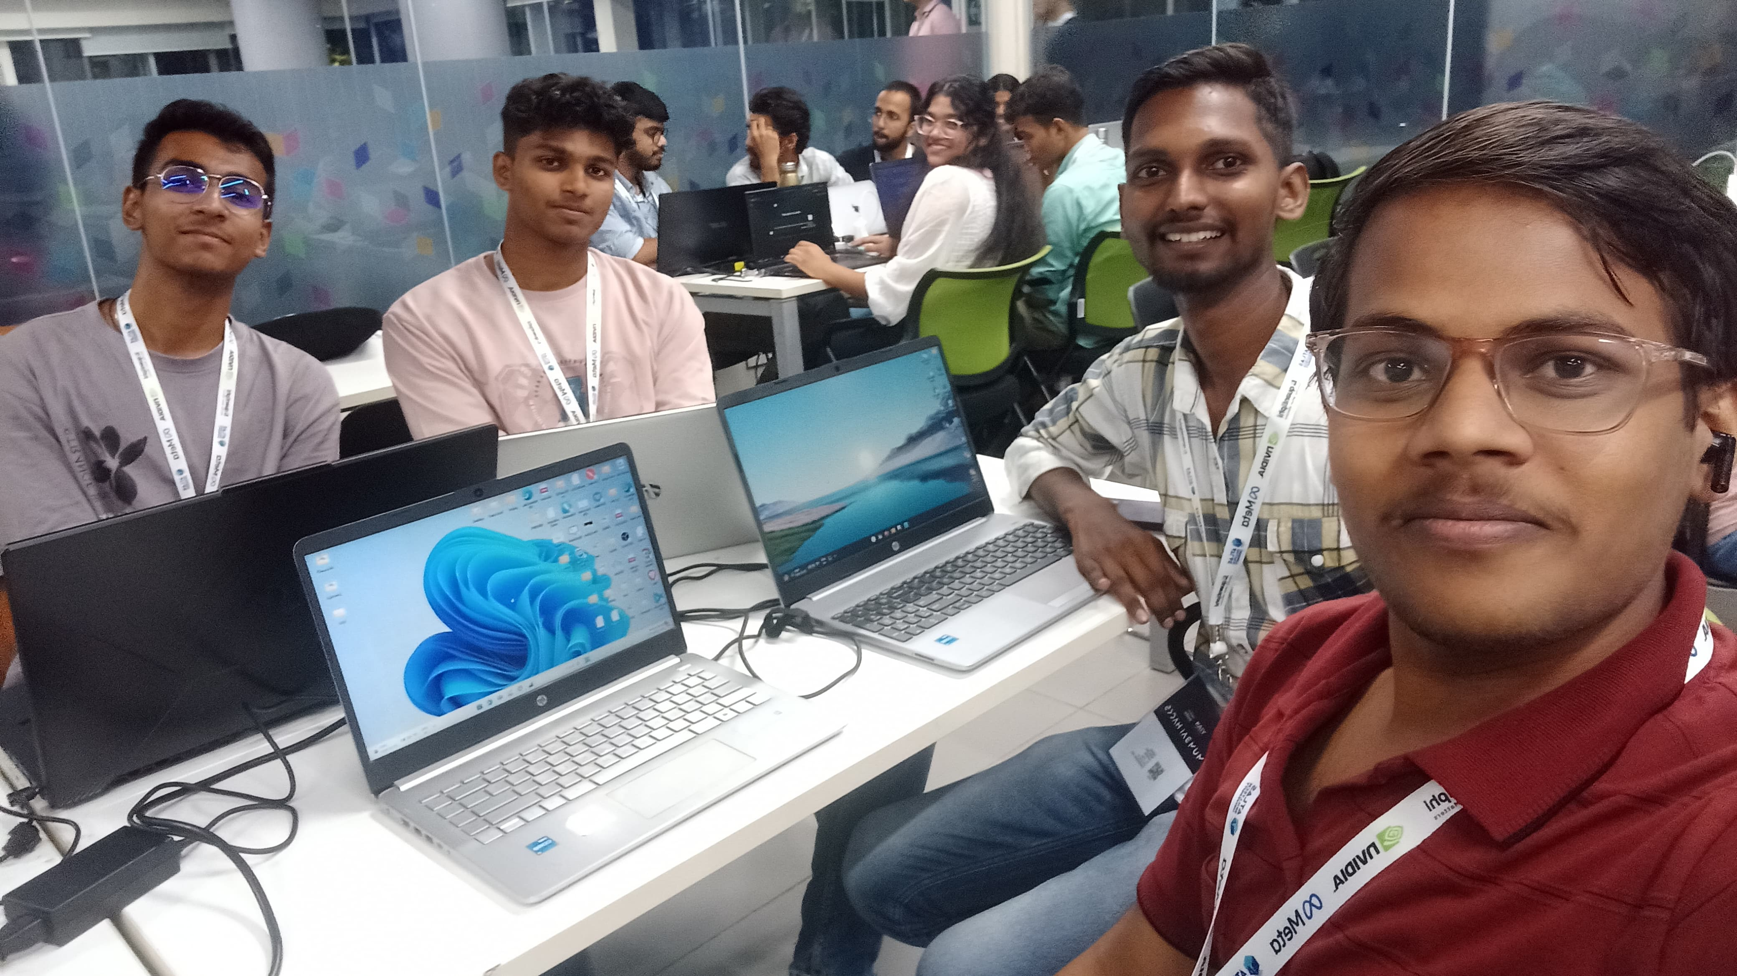
Team Photo

Slide 4
Describe your solution
The AI-Based Smart Agriculture Assistant leverages satellite imagery, weather data, and machine learning to provide farmers with real-time monitoring, predictive analytics, and actionable insights for efficient crop management. By analyzing weather patterns, soil quality data, and crop health indicators, it offers early warnings on risks such as pest infestations and adverse weather conditions. The assistant provides optimized recommendations for irrigation, fertilization, and pest control to improve yields while minimizing resource use

Slide 5
Thank you

